Slide 1
Defender for IoT Product Demonstration
Ariel Saghiv
Senior Program Manager
Azure Partner Security Deep-Dive
Notes:
- Hello everyone my name is
- Thank you for joining today
- And Thank you Liz for the introduction
- I am a Program Manager for the Azure Defender for IoT, joining with the recent acquisition of CyberX which specialized in securing IoT devices for industrial and critical infrastructure organizations
Feel free to ask questions in the chat my team will help with Q&A,
and I will will be kicking off this presentation

Slide 2

Agenda
Understanding the IoT/OT Risk
Introducing Azure Defender for IoT
Product Demonstration
Learn More
Notes:
Which topics will be part of our mutual exploration today, and what value can I leave you with?
- First, I will describe the challenges faced by organizations using IoT devices which are applicable to all industries,
- Next I will present and demonstrate how Azure Defender for IoT can help your organization, Increase Operational Efficiency as well as protect People, Production & Profits
- I will finish off with pointers to some useful resources you can follow up after this session.

Slide 3
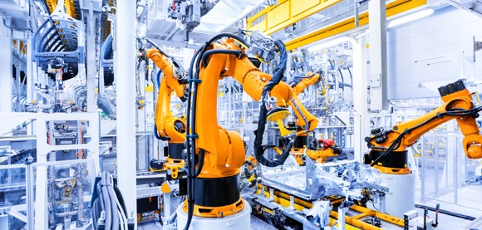


IoT/OT risk = Business Risk
Financial
IP Theft
Safety
Plant shut-downs and production downtime, damaged goods and brand name causing billions of dollars in losses (WannaCry, NotPetya, LockerGoga)
Manufacturers are 8x more likely to be attacked by theft of intellectual property such as proprietary formulas and designs than other verticals (DBIR).
Safety of employees, the environment and infrastructure, such as the controllers in a petrochemical facility compromised with purpose-built back door in TRITON attack.
Notes:
What is the risk for businesses using IoT/OT?
Since the invention of the PLC in 1969, for the last 50 years we have been installing, upgrading, automating and re-engineering business-critical production networks
Reliability was always part of the design, cyber-security was not
Then came the internet
Business face:
- Financial Risks – shut down plants, lost production, damaged goods, brand name and customer trust
- Theft of Intellectual Property – which affects industries ranging from soft drink to pharma and medical research
- Safety Risks – to employees, to the environment, and as we know of cases where infrastructure turned into a weapon

Slide 4
IoT & ICS Security Maturity Model
 | Level 1 | Level 2 | Level 3 | Level 4
Asset Management
Threat Detection
Integrating Security and Operational Teams
Notes:
How can we measure how secure our organization is?
Organization Maturity can be broken down into 3 groups
Asset discovery and management
Continuous monitoring for threats
Integrating both by technology and process the security and operational teams to work together creating effective collaboration

Slide 5
IoT & ICS Security Maturity Model
 | Level 1 | Level 2 | Level 3 | Level 4
Asset Mgt | Asset documentation Spreadsheet | Dynamic Asset documentation | Alerting when new assets appear and retire | Integration with Asset Inventory database (CMDB)
 | Static network map | Accurate spreadsheet with IPs | Accurate network map with all assets in network topology | Automated network topology with device communications & protocol visibility
Threat Detection | No Anomaly Detection (AD) | AD via manual log review & signature-based alerts (IDS) | AD via continuous monitoring with behavioral analytics using self-learning | AD via continuous monitoring with behavioral analytics using self-learning and remediation processes
 | No incident response | Manual incident response | Automated incident response & threat hunting. Reviewed occasionally | Automated incident response & threat hunting with supporting processes and dedicated personal
 | No risk & vulnerability assessment | Yearly risk & vulnerability assessment | Automated risk & vulnerability assessment | Automated risk & vulnerability assessment with prioritized remediation
IT & OT Integration | No threat modeling | Manual threat modeling | Automated threat modeling | Automated threat modeling and proactive remediation efforts
 | No alignment between security & operational teams | Planning alignment between security & operational teams | Basic integration of SOC for OT environment | Integrated SOC for OT environment with process and procedures fully defined an operational while sharing VA information
Notes:
How can we know where we are on the scale?
Organizations start up in the model at level 1 where...
Up to level 4 where tools, knowledge and processes become routine, laser focused tasks keeping the organization on top of cybersecurity.

Slide 6




Defender for IoT: Agentless Security for Unmanaged Devices
Purpose-built OT security platform for Industrial IoT networks
Deep knowledge of specialized OT protocols & devices across diverse OT suppliers (GE, Rockwell, Schneider, Emerson, Siemens, ABB, Yokogawa, etc.)
Infused with IoT/OT specific Threat Intelligence
Deploys in minutes with zero performance impact and 100% passive by default
Native integration with existing IT security stacks (Azure Sentinel, Splunk, ServiceNow, etc.)
Notes:
How can Microsoft and Azure Defender for IoT help an organization evolve and mature faster?

Slide 7



Differentiating by Security Research
OneDrive
Shared threat data from partners, researchers, and law enforcement worldwide
Countering adversary-based threats to Microsoft and its customers through dissemination of threat intelligence, proactive hunting and research.
200+ global cloud consumer and commercial services
Outlook
MSTIC
470B+ emails analyzed
1.2B+ devices scanned each month
5B+ threats detected on devices every month and IoT/OT specific threat intel
Botnet data from Microsoft Digital Crimes Unit
DART
CDOC
Azure
Windows
Enterprise security for 90% of Fortune 500
Microsoft accounts
MSRC
18M+ URLs scanned monthly
Bing
iOS, macOS, Android, Linux, IoT devices
1.8PBs Cloud and network logs
DCU
Xbox Live
Notes:
What differentiates Azure Defender for IoT?
One of Microsoft’s key advantages is the broad spectrum of intelligence signals with no parallel in the industry, researched by security experts in teams such as MSTIC and Section 52 for IoT specific intelligence
Research teams focus on malicious emails, the consumer and enterprise clouds and services, botnets, endpoints and IoT devices which are all part of the Microsoft Intelligent Security Graph.
This is how we describe the way that we synthesize a vast amount of data from a huge variety of sources. 400 billion emails get analyzed by our Outlook.com and Office 365 email services every month.
1.2 billion devices get scanned every month by Windows Defender. That gives us a great deal of signal into what's happening on endpoints, and where are the attacks, and how to detect them
And so, we see more attacks than most other companies on any given day. We get a lot of information from defending against those attacks.
On top of all of that we layer shared threat data that we get from our partners, from the researchers here at Microsoft who are part of our 3,500-plus people that are full time on security, and law enforcement agencies that we partner with worldwide through our digital crimes unit. All of that intelligence makes up the Intelligent Security Graph.
And why is it a graph? It's a graph because what's important is connecting these pieces of intelligence, so that these signals are not just individual points of information. The graph brings them together as something that we can draw patterns across. We can learn from one point of data to influence how we interpret another point of data.
So, the Intelligent Security Graph is something that we are very, very heavily invested in at Microsoft. It's something that we feel is unique to us in this industry.
----
(We operate 200-plus global cloud, consumer, and commercial services. Everything from outlook.com to Xbox Live to Office 365 to Azure, and so on. And with all of those services, we have a tremendous amount of surface area that we defend. Enterprise Security from Microsoft is employed by 90% of the Fortune 500.)

Slide 8

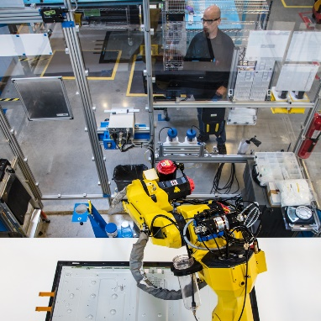
IT≠ OT IT & OT Security – A Different Mindset
IT Security
OT Security
Data confidentiality & privacy
Focus on safety & availability
Based on standard protocols & devices
Specialized protocols, devices & legacy OS platforms
High levels of connectivity
Traditionally air-gapped
Multiple layers of controls & telemetry
Little or no visibility into IoT/OT risk
Notes:
Why are OT networks different and require a different mindset?

Slide 9






Events that Affect IoT/OT Networks
Behavioral
Anomalies
Unusual M2M Communications
Operational Issues
Protocol Violations
Industrial Malware
Notes:
Due to the distributed and out of sight nature of IoT networks, different monitoring tools and understanding of the network is required in order to maintain safety and availability.
Typically these networks cannot be updated routinely and may operate for years using the same setup, legacy operating systems which do not even support newer software.
How can we classify the different types of events that may impact an IoT network and require immediate attention?

Slide 10
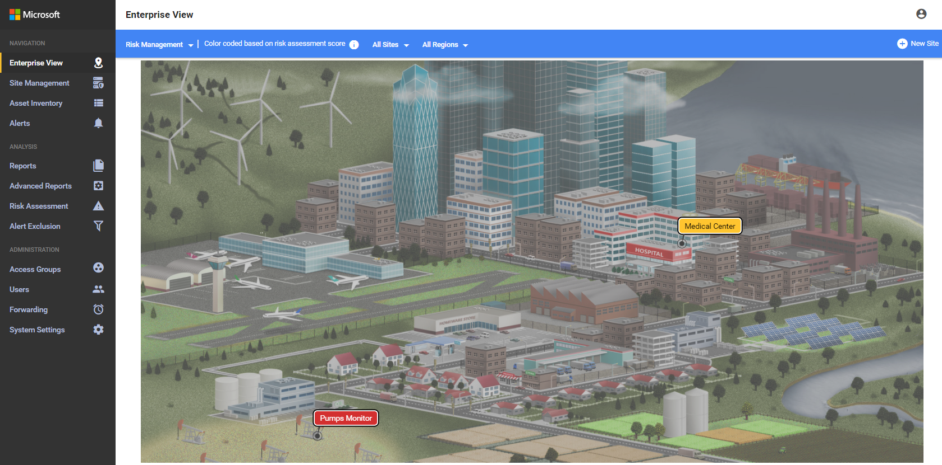
Examples of real-time IoT/OT threat alerts
Unauthorized Changes to the Network
Unauthorized device connected to the network
Unauthorized connection to the internet
Unauthorized remote access
Operational Events which Require Attention
“PLC Stop” and other potentially malicious commands
Changes to firmware versions
Unauthorized PLC programming
Device is suspected of being disconnected
Malicious or Anomalous Events
Network scanning operation detected
Known malware detected (e.g., WannaCry, EternalBlue)
Unauthorized SMB login
Network Protocol Abnormalities
Ethernet/IP CIP service request failure
BACnet operation failed
Illegal DNP3 operation
Master-slave authentication error
Notes:
How should the following events be managed in a critical IoT network?
Protocol Violation - Packet Structure or Field Values That Don't Comply with Protocol Specification
Policy Violation - Deviation from Baseline Behavior Defined in Learned or Configured Policy
Malware - Detection of Malicious Network Activity
Anomaly - Anomaly in Network Behavior
Operational - Operational Incidents or Malfunctioning Entities

Slide 11

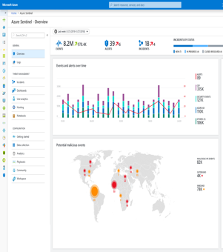
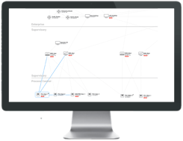




Azure Defender for IoT - Non-Invasive Deployment and Agentless Monitoring
Sensor performs Deep Packet Inspection (DPI) using patented, IoT-aware behavioral analytics
SIEM/SOAR
Azure Security Center and/or local web console
Virtual or physical appliance
Assets
Vulnerabilities
Threats
Alerts
Network
Packet Capture
SPAN port
OT Network
OT Network
Notes:
Why is our product simple to deploy and does not impact the organization or it’s assets and networks?
Azure defender for IoT is an non-invasive agentless monitoring platform
Passive monitoring allows Zero Impact on the network with frameworks in place for any industrial protocol
Once the sensor monitors the network, it maps out the network assets, identifies vulnerabilities and continuously monitors for threats.
Azure defender for IoT is a scalable solution allowing for monitoring in multiple locations providing the owner to scale the system as it grows, enabling management both on premises or in the cloud

Slide 12

Challenges Addressed by Azure Defender for IoT
IoT/OT Asset Discovery
What devices do we have & how are they communicating — how can we easily implement better segmentation & zero-trust policies?
Risk & Vulnerability Management
What critical IoT vulnerabilities require immediate attention - and how do we prioritize mitigation?
Continuous IoT/OT Threat Monitoring, Incident Response & Threat Intelligence
How do we know if we have any IoT/OT threats in our network right now — and how do we quickly respond to them?
Operational Efficiency
How do we identify & rapidly eliminate inefficiencies from misconfigured or compromised networks and equipment?
Unified IT/OT Security Monitoring & Governance
How do we leverage existing people, training & tools to centralize IT/OT security in our SOCs?
How to demonstrate to auditors that we have a safety- and security-first environment?
Notes:
Let me introduce Richard, the new chief security officer who would like to improve the security posture and IoT monitoring in the new production plants our organization has just commissioned.
What challenges is Richard facing in order to reach his goal?

Slide 13
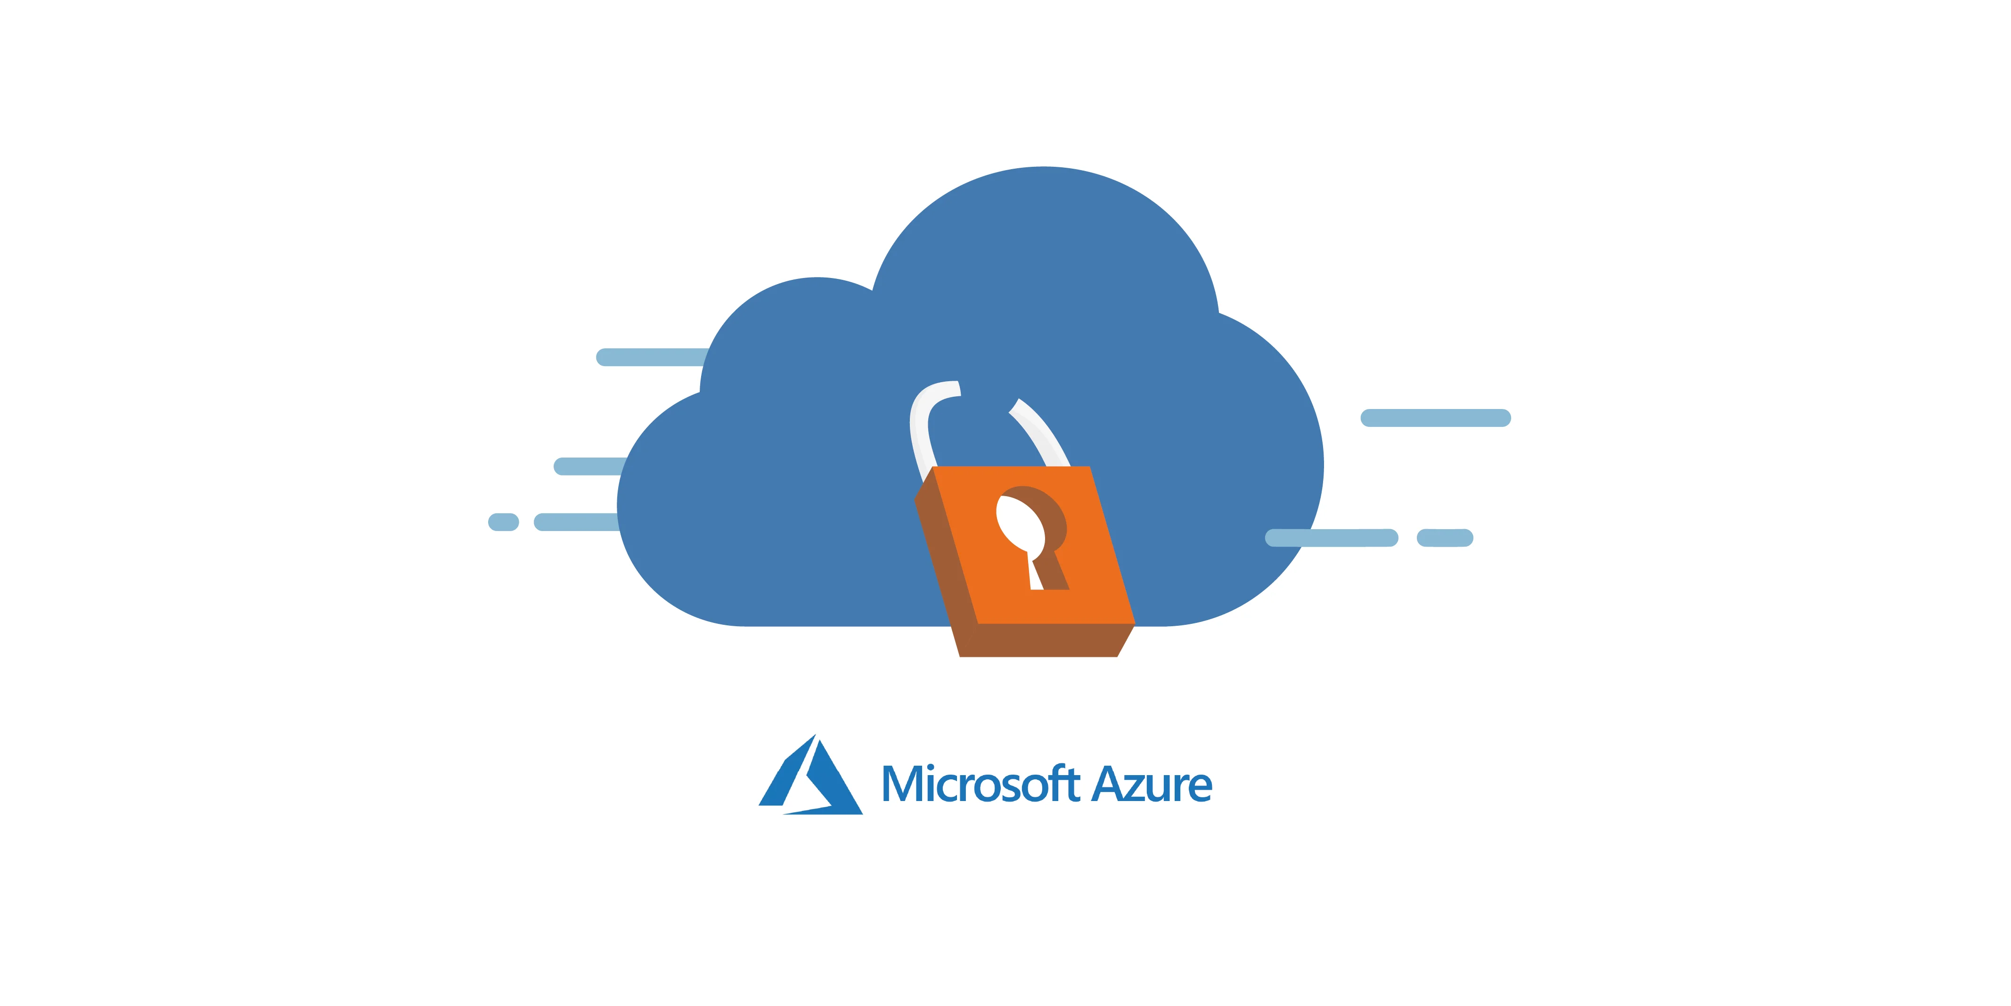
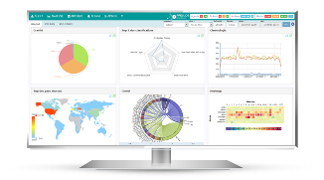
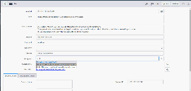
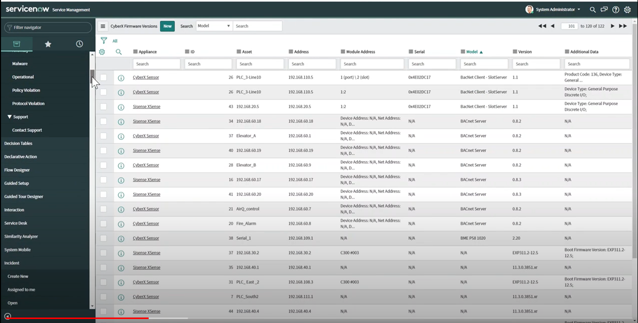


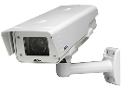
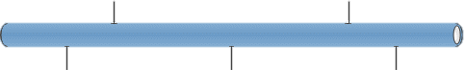









Multi-Layer, Multi-Tenant Architecture
Data Center / Industry 4.0 / SOC / MSSP
ITSM
SIEM
Asset Management
Integration / Cloud
On-Premises
NGFW
Enterprise
Corporate Network
IT
SSL
SSL
SSL
Defender for IoT
Mgmt
Mgmt
Mgmt
OT
NGFW
Defender for IoT
Sensor
Defender for IoT
Sensor
Defender for IoT
Sensor
Port Mirroring
One-Way
Port Mirroring
One-Way
Port Mirroring
One-Way
Port Mirroring
Industrial DMZ
IDMZ
Air-Gapped
Industrial Zone 1
Air-Gapped
Industrial Zone 2
Air-Gapped
Industrial Zone 3
SCADA / DCS
Security Update
Server
Domain
Controller
Production Floor
Confidential
NGFW
Notes:
After the success of the monitoring project on the new production plant, Richard would like to grow the system and monitor more networks across the organization. How can Richard deploy and monitor across the organization?
The platform supports deployment and management of multiple appliances monitoring different parts of the networks
Allowing for deployment in multiple topologies, supporting the most secure air gapped networks
The management console provides a central viewport helping the security teams to focus top-down on the day to day upkeep of the organization, and to perform easy triage of events.
The management console allows for managing the inventories and alerts across the organization from a single pane of glass.

Slide 14











Unified, End-to-End Protection For Greenfield & Brownfield Environments
Runs On-Premises
Runs on Azure
Unmanaged
(Brownfield)
Unified IT & OT Governance
Alerts & incidents
Investigations & threat hunting
OT-specific SOAR playbooks
OT-specific threat intelligence
On-Premises Console
Azure Sentinel
Network Switch
Azure Defender for IoT
Network Sensor
Asset inventory
Vulnerability management
Continuous threat monitoring
Asset inventory
Vulnerability management
Continuous threat monitoring
Azure Defender
for IoT
Managed
(Greenfield)
Security Module
Windows
Linux
RTOS
Azure Sphere
Cloud Gateway
IoT Device Management
Azure IoT Edge
Azure IoT Hub
Notes:
What makes Azure Defender for IoT the unified and futureproof solution for an organization?
- Azure Defender for IoT is built for both local management and the cloud, connecting to Microsoft Azure cloud interfacing to products such as Sentinel, Power BI and other services on the Azure cloud ecosystem.
- Moreover, Microsoft works with device builders in order to integrate security modules into new IoT platforms and products, allowing for a unified view of all managed and unmanaged IoT devices across the organization

Slide 15
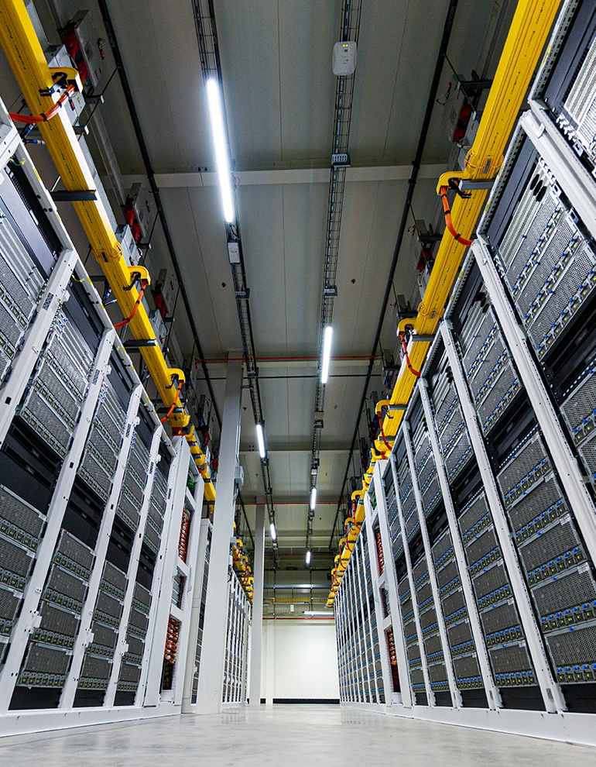
Learn more
Tech Community:
IoT Security - Microsoft Tech Community
Learn about product at:
http://aka.ms/ADforIoT-Product
http://aka.ms/ADforIoT-PP-Blog
Product Documentation
Azure Sphere | Microsoft Azure
View on-demand webinars:
SANS: Bringing IT & OT Together — Expert Roundtable
SANS: A Principal Control Engineer’s Perspective on Defending Energy Utilities from IoT/ICS Attacks
Zero-Trust for IoT/OT Networks
Read our white papers, solution briefs & blog posts
MITRE ATT&CK for ICS
NIST Recommendations for IoT/ICS Security
TRITON Attack & OT Living-Off-The-Land Tactics
How IoT is Changing the CISO Role (Dark Reading)
Security Maturity Model
Notes:
Summary
We now understand the risk organizations face by the increasing number of IoT devices taking part in critical business processes, and reviewed the solution offered by Microsoft to organizations willing to protect people, production and profits.
How can you learn more about the solution and get started?
We’ve prepared some extra resources and invite you to read through the product briefs as well as join our IoT security community to learn more and help your organization get started on your journey of IoT security.

Slide 16
Questions?
Notes:
In case you have any questions further questions, please write them in the chat so we can address them.
Let me review the questions asked during the session, possibly by Richard the CISO who is looking to better utilize Azure Defender for IoT

Slide 17
Thank you. Ariel Saghiv asaghiv@microsoft.com
Notes:
I would like to thank you for this opportunity to present to you, and invite you to touch base with us for any more information.

